Slide 1
Minimum Spanning Tree
Course Code: CSC2211
Course Title: Algorithms
Dept. of Computer Science
Faculty of Science and Technology
Lecturer No: | 11 | Week No: | 11 | Semester: | Spring 2020-21
Lecturer: | Mushfiqur Rahman; mushfiqur@aiub.edu

Slide 2
Lecture Outline
Recalling Spanning Tree.
What is Minimum Spanning Tree (MST).
Applications of MST.
Prim-Jarnik’s Algorithm.
Kruskal’s Algorithm

Slide 3
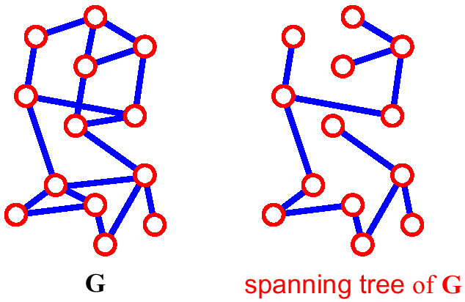
Spanning Tree.
A spanning tree of G is a subgraph which is a tree that
contains all vertices of G and no cycle.
If a graph G has v vertices and e number of edges, then a spanning tree of that graph will have n vertices and (n-1) number of edges.

Slide 4
Minimum Spanning Tree (MST)
Definition
A minimum spanning tree (MST) or minimum cost spanning
tree is a subset of the edges of a connected, weighted
undirected graph that connects all the vertices together,
without any cycles and with the minimum possible total
edge weight.

Slide 5
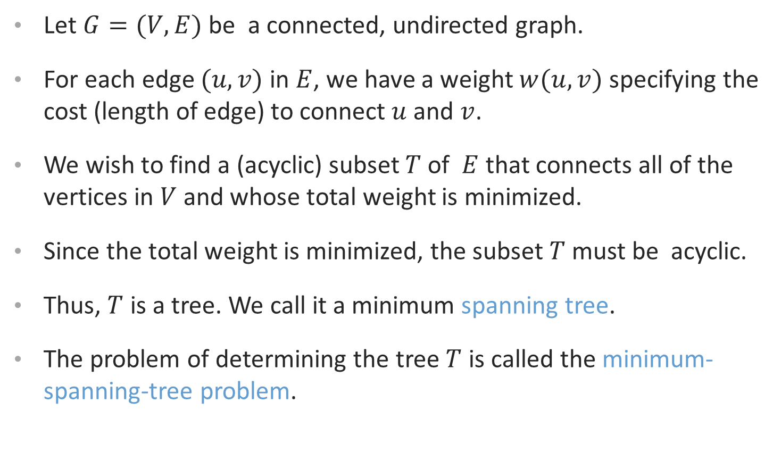
MST….
Let $G=(V,E)$ be a connected, undirected graph.
For each edge $(u,v)$ in $E$, we have a weight $w(u,v)$ specifying the cost (length of edge) to connect $u$ and $v$.
We wish to find a (acyclic) subset $T$ of $E$ that connects all of the vertices in $V$ and whose total weight is minimized.
Since the total weight is minimized, the subset $T$ must be acyclic.
Thus, $T$ is a tree. We call it a minimum spanning tree.
The problem of determining the tree $T$ is called the minimum-spanning-tree problem.

Slide 6
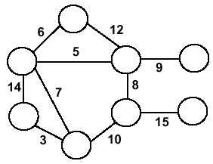
Minimum Spanning Trees (MST)
Undirected, connected graph
G = (V,E)
Weight W

Slide 7
Minimum Spanning Trees (MST)
Undirected, connected graph
G = (V,E)
Weight W
Spanning tree: A spanning tree is a sub-graph of a graph that contains or connects all the vertices and has no cycle.

Slide 8
Minimum Spanning Trees (MST)
Undirected, connected graph
G = (V,E)
Weight W
Minimum spanning tree (MST): Spanning tree where total weight of the tree is minimum.

Slide 9
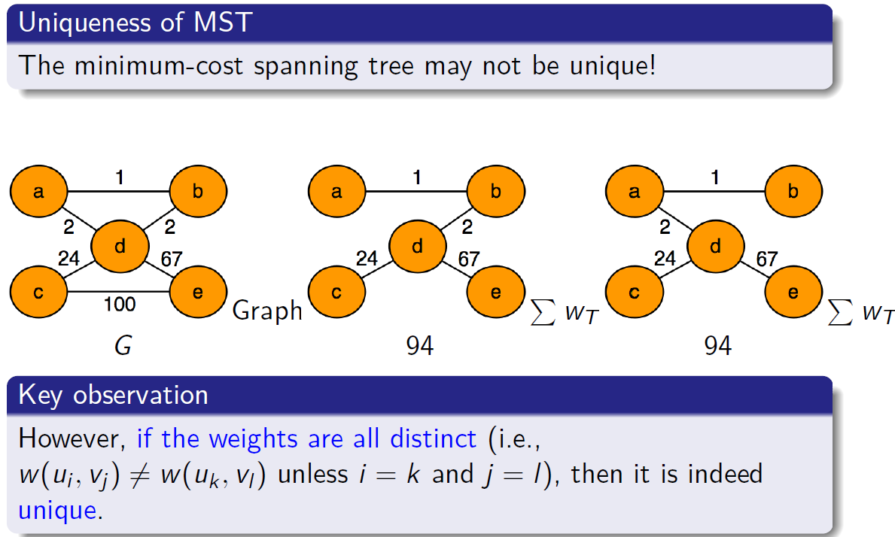
Minimum Spanning Tree (MST)

Slide 10
Application…..
In the design of electronic circuitry, it is often necessary to make a set of pins electrically equivalent by wiring them together.
To interconnect n pins, we can use n-1 wires, each connecting two pins.
We want to minimize the total length of the wires.
Minimum Spanning Trees can be used to model this problem.

Slide 11
Problem: Laying Telephone Wire
Central office

Slide 12
Wiring: Naïve Approach
Central office
Expensive!

Slide 13
Wiring: Better Approach
Central office
Minimize the total length of wire connecting the customers

Slide 14
Prim-Jarnik’s Algorithm
Q
8
6
D
Node | Pred | W
A | NIL | 0
B | NIL | ∞
C | NIL | ∞
D | NIL | ∞
E | NIL | ∞
F | NIL | ∞
G | NIL | ∞
H | NIL | ∞
I | NIL | ∞
B
C
4
A
3
4
13
9
12
6
I
8
H
10
5
F
E
3
MST-Prim(Graph,A)
1
G
S
Node
Pred
W

Slide 15
Prim-Jarnik Algorithm
Vertex based algorithm
Grows a single MST T one vertex at a time
The set S covers the portion of T that was already computed
Annotate all vertices v outside of the set S. The minimum weight of an edge that connects v to a vertex in S is w. (w = ∞ if no edge exists)

Slide 16
Prim-Jarnik’s Example
Q
8
6
D
Node | Pred | W
A | NIL | 0
B | NIL | ∞
C | NIL | ∞
D | NIL | ∞
E | NIL | ∞
F | NIL | ∞
G | NIL | ∞
H | NIL | ∞
I | NIL | ∞
B
C
4
A
3
4
13
9
12
6
I
8
H
10
5
F
E
3
MST-Prim(Graph,A)
1
G
S
Node
Pred
W

Slide 17
...Prim-Jarnik’s Example
Q
8
6
D
Node | Pred | W
B | A | 4
H | A | 8
C | NIL | ∞
D | NIL | ∞
E | NIL | ∞
F | NIL | ∞
G | NIL | ∞
I | NIL | ∞
B
C
4
3
4
13
9
A
12
6
I
8
H
10
5
F
E
3
1
G
S
Node | A
Pred | NIL
W | 0

Slide 18
...Prim-Jarnik’s Example
Q
8
6
D
Node | Pred | W
H | A | 8
C | B | 8
F | NIL | ∞
E | NIL | ∞
F | NIL | ∞
G | NIL | ∞
I | NIL | ∞
B
C
4
A
3
4
13
9
12
6
I
8
H
10
5
F
E
3
1
G
S
Node | A | B
Pred | NIL | A
W | 0 | 4

Slide 19
...Prim-Jarnik’s Example
Q
8
6
D
Node | Pred | W
G | H | 1
I | H | 6
C | B | 8
D | NIL | ∞
E | NIL | ∞
F | NIL | ∞
B
C
4
A
3
4
13
9
12
6
I
8
H
10
5
F
E
3
1
G
S
Node | A | B | H
Pred | NIL | A | A
W | 0 | 4 | 8

Slide 20
...Prim-Jarnik’s Example
Q
Node | Pred | W
F | G | 3
I | G | 5
C | B | 8
D | NIL | ∞
E | NIL | ∞
8
6
D
B
C
4
A
3
4
13
9
12
6
I
8
H
10
5
F
E
3
1
G
S
Node | A | B | H | G
Pred | NIL | A | A | H
W | 0 | 4 | 8 | 1

Slide 21
...Prim-Jarnik’s Example
Q
8
6
D
C
Node | Pred | W
C | F | 4
I | G | 5
E | F | 10
D | F | 13
4
B
A
3
4
13
9
12
6
I
8
H
10
5
F
E
3
1
G
S
Node | A | B | H | G | F
Pred | NIL | A | A | H | G
W | 0 | 4 | 8 | 1 | 3

Slide 22
...Prim-Jarnik’s Example
6
Q
8
C
D
4
B
Node | Pred | W
I | C | 3
D | C | 6
E | F | 10
A
3
4
13
9
12
6
I
8
H
10
5
F
E
3
1
G
S
Node | A | B | H | G | F | C
Pred | NIL | A | A | H | G | F
W | 0 | 4 | 8 | 1 | 3 | 4

Slide 23
...Prim-Jarnik’s Example
6
Q
8
C
D
4
B
Node | Pred | W
D | C | 6
E | F | 10
A
3
4
13
9
12
6
I
8
H
10
5
F
E
3
1
1
G
S
Node | A | B | H | G | F | C | I
Pred | NIL | A | A | H | G | F | C
W | 0 | 4 | 8 | 1 | 3 | 4 | 3

Slide 24
...Prim-Jarnik’s Example
Q
8
6
D
C
Node | Pred | W
E | D | 9
4
B
A
3
4
13
9
12
6
I
8
H
10
5
F
E
3
1
G
S
Node | A | B | H | G | F | C | I | D
Pred | NIL | A | A | H | G | F | C | C
W | 0 | 4 | 8 | 1 | 3 | 4 | 3 | 6

Slide 25
...Prim-Jarnik’s Example
Q is empty
8
6
D
C
Node | Pred | W
4
B
A
3
4
13
9
12
6
I
8
H
10
5
F
E
3
1
G
S
Node | A | B | H | G | F | C | I | D | E
Pred | NIL | A | A | H | G | F | C | C | D
W | 0 | 4 | 8 | 1 | 3 | 4 | 3 | 6 | 9

Slide 26
...Prim-Jarnik’s Example
Q is empty
6
D
C
Node | Pred | W
4
B
A
3
4
9
8
I
H
E
3
F
1
G
S
Node | A | B | H | G | F | C | I | D | E | Total Cost
Pred | NIL | A | A | H | G | F | C | C | D
W | 0 | 4 | 8 | 1 | 3 | 4 | 3 | 6 | 9 | 38

Slide 27
Kruskal's Algorithm
Edge based algorithm
Add edges one at a time in increasing weight order.
The algorithm maintains S: a forest of trees.
An edge is accepted if it connects vertices of distinct trees (the cut respects S) and does not create any cycle.

Slide 28
Kruskal’s Example
8
6
D
B
C
4
A
3
4
13
9
12
6
I
8
H
10
5
F
E
3
1
G
S = { A, B, C, D, E, F, G, H, I }
E’ = { HG-1, CI-3, GF-3, CF-4, AB-4, HI-6, CD-6, BC-8, AH-8, DE-9, EF-10, BH-12, DF-13 }
S = { A, B, C, D, E, F, G, H, I }
E = { HG-1, CI-3, GF-3, CF-4, AB-4, HI-6, CD-6, BC-8, AH-8, DE-9, EF-10, BH-12, DF-13 }
E’ = { }
S is the set of distinct tree(s).
E is the min priority queue of the graph edges.
E’ is the queue of the minimum spanning tree edges.

Slide 29
Kruskal’s Example
8
6
D
B
C
4
A
3
4
13
9
12
6
I
8
H
10
5
F
E
3
1
G
S = { A, B, C, D, E, F, G, H, I }
E’ = { HG-1, CI-3, GF-3, CF-4, AB-4, HI-6, CD-6, BC-8, AH-8, DE-9, EF-10, BH-12, DF-13 }
S = { A, B, C, D, E, F, G, H, I }
E = { HG-1, CI-3, GF-3, CF-4, AB-4, HI-6, CD-6, BC-8, AH-8, DE-9, EF-10, BH-12, DF-13 }
E’ = { }
S is the set of distinct tree(s).
E is the min priority queue of the graph edges.
E’ is the queue of the minimum spanning tree edges.

Slide 30
...Kruskal’s Example
8
6
D
B
C
4
A
3
4
13
9
12
6
I
8
H
10
5
F
E
3
1
G
S = { A, B, C, D, E, F, GH, I }
E = { CI-3, GF-3, CF-4, AB-4, HI-6, CD-6, BC-8, AH-8, DE-9, EF-10, BH-12, DF-13 }
E’ = { HG-1 }
S is the set of distinct tree(s).
E is the min priority queue of the graph edges.
E’ is the queue of the minimum spanning tree edges.

Slide 31
...Kruskal’s Example
8
6
D
B
C
4
A
3
4
13
9
12
6
I
8
H
10
5
F
E
3
1
G
S = { A, B, CI, D, E, F, GH }
E = { GF-3, CF-4, AB-4, HI-6, CD-6, BC-8, AH-8, DE-9, EF-10, BH-12, DF-13 }
E’ = { HG-1, CI-3 }
S is the set of distinct tree(s).
E is the min priority queue of the graph edges.
E’ is the queue of the minimum spanning tree edges.

Slide 32
...Kruskal’s Example
8
6
D
B
C
4
A
3
4
13
9
12
6
I
8
H
10
5
F
E
3
1
G
S = { A, B, CI, D, E, FGH }
E = { CF-4, AB-4, HI-6, CD-6, BC-8, AH-8, DE-9, EF-10, BH-12, DF-13 }
E’ = { HG-1, CI-3, GF-3 }
S is the set of distinct tree(s).
E is the min priority queue of the graph edges.
E’ is the queue of the minimum spanning tree edges.

Slide 33
...Kruskal’s Example
8
6
D
B
C
4
A
3
4
13
9
12
6
I
8
H
10
5
F
E
3
1
G
S = { A, B, CFGHI, D, E }
E = { AB-4, HI-6, CD-6, BC-8, AH-8, DE-9, EF-10, BH-12, DF-13 }
E’ = { HG-1, CI-3, GF-3, CF-4 }
S is the set of distinct tree(s).
E is the min priority queue of the graph edges.
E’ is the queue of the minimum spanning tree edges.

Slide 34
...Kruskal’s Example
8
6
D
B
C
4
A
3
4
13
9
12
6
I
8
H
10
5
F
E
3
1
G
S = { AB, CFGHI, D, E }
E = { HI-6, CD-6, BC-8, AH-8, DE-9, EF-10, BH-12, DF-13 }
E’ = { HG-1, CI-3, GF-3, CF-4, AB-4 }
S is the set of distinct tree(s).
E is the min priority queue of the graph edges.
E’ is the queue of the minimum spanning tree edges.

Slide 35
...Kruskal’s Example
8
6
D
B
C
4
A
3
4
13
9
12
6
I
8
H
10
5
F
E
3
1
G
S = { AB, CFGHI, D, E }
E = { CD-6, BC-8, AH-8, DE-9, EF-10, BH-12, DF-13 }
E’ = { HG-1, CI-3, GF-3, CF-4, AB-4 }
S is the set of distinct tree(s).
E is the min priority queue of the graph edges.
E’ is the queue of the minimum spanning tree edges.

Slide 36
...Kruskal’s Example
8
6
D
B
C
4
A
3
4
13
9
12
6
I
8
H
10
5
F
E
3
1
G
S = { AB, CDFGHI, E }
E = { BC-8, AH-8, DE-9, EF-10, BH-12, DF-13 }
E’ = { HG-1, CI-3, GF-3, CF-4, AB-4, CD-6 }
S is the set of distinct tree(s).
E is the min priority queue of the graph edges.
E’ is the queue of the minimum spanning tree edges.

Slide 37
...Kruskal’s Example
8
6
D
B
C
4
A
3
4
13
9
12
6
I
8
H
10
5
F
E
3
1
G
S = { ABCDFGHI, E }
E = { AH-8, DE-9, EF-10, BH-12, DF-13 }
E’ = { HG-1, CI-3, GF-3, CF-4, AB-4, CD-6, BC-8 }
S is the set of distinct tree(s).
E is the min priority queue of the graph edges.
E’ is the queue of the minimum spanning tree edges.

Slide 38
...Kruskal’s Example
8
6
D
B
C
4
A
3
4
13
9
12
6
I
8
H
10
5
F
E
3
1
G
S = { ABCDFGHI, E }
E = { DE-9, EF-10, BH-12, DF-13 }
E’ = { HG-1, CI-3, GF-3, CF-4, AB-4, CD-6, BC-8 }
S is the set of distinct tree(s).
E is the min priority queue of the graph edges.
E’ is the queue of the minimum spanning tree edges.

Slide 39
...Kruskal’s Example
8
6
D
B
C
4
A
3
4
13
9
12
6
I
8
H
10
5
F
E
3
1
G
S = { ABCDEFGHI }
E = { EF-10, BH-12, DF-13 }
E’ = { HG-1, CI-3, GF-3, CF-4, AB-4, CD-6, BC-8, DE-9 }
S is the set of distinct tree(s).
E is the min priority queue of the graph edges.
E’ is the queue of the minimum spanning tree edges.

Slide 40
...Kruskal’s Example
8
6
D
B
C
4
A
3
4
9
I
H
E
3
F
1
G
S = { ABCDEFGHI }
E = { }
E’ = { HG-1, CI-3, GF-3, CF-4, AB-4, CD-6, BC-8, DE-9 } Total Cost := 38
S is the set of distinct tree(s).
E is the min priority queue of the graph edges.
E’ is the queue of the minimum spanning tree edges.

Slide 41
Summary
Prim’s algorithm
Select any vertex
Select the shortest edge connected to that vertex
Select the shortest edge connected to any vertex already connected
Repeat step 3 until all vertices have been connected
Kruskal’s algorithm
Select the shortest edge in a network
Select the next shortest edge which does not create a cycle
Repeat step 2 until all vertices have been connected

Slide 42
Summary
Both are greedy algorithms
Both have the same output→ MST
Kruskal’s begins with forest and merge into a tree
Prim’s always stays as a tree

Slide 43
Books
Introduction to Algorithms, Thomas H. Cormen, Charle E. Leiserson, Ronald L. Rivest,
Clifford Stein (CLRS).
Fundamental of Computer Algorithms, Ellis Horowitz, Sartaj Sahni,
Sanguthevar Rajasekaran (HSR)

Slide 44
References
https://www.geeksforgeeks.org/kruskals-minimum-spanning-tree-algorithm-greedy-algo-2/
https://www.geeksforgeeks.org/applications-of-minimum-spanning-tree/
https://www.tutorialspoint.com/data_structures_algorithms/prims_spanning_tree_algorithm.htm
https://www.tutorialspoint.com/data_structures_algorithms/kruskals_spanning_tree_algorithm.htm
https://www.cs.usfca.edu/~galles/visualization/Prim.html
https://visualgo.net/en/mst?slide=1

